Slide 1
Rounding integers to one significant figure
Estimation and rounding

Slide 2
how to use Oak lessons

Slide 3
I can round integers to one significant figure.

Slide 4
Significant figures are the digits in a number that contribute to the accuracy of the number. The first significant figure is the first non-zero digit.
Round − To change a number into another number that is approximately the same value but is easier to work with. E.g. Round 561 to the nearest 10 is 560.

Slide 5

Rounding integers to one significant figure
Identifying significant figures
Using a number line for significant figures
Rounding to one significant figure

Slide 6
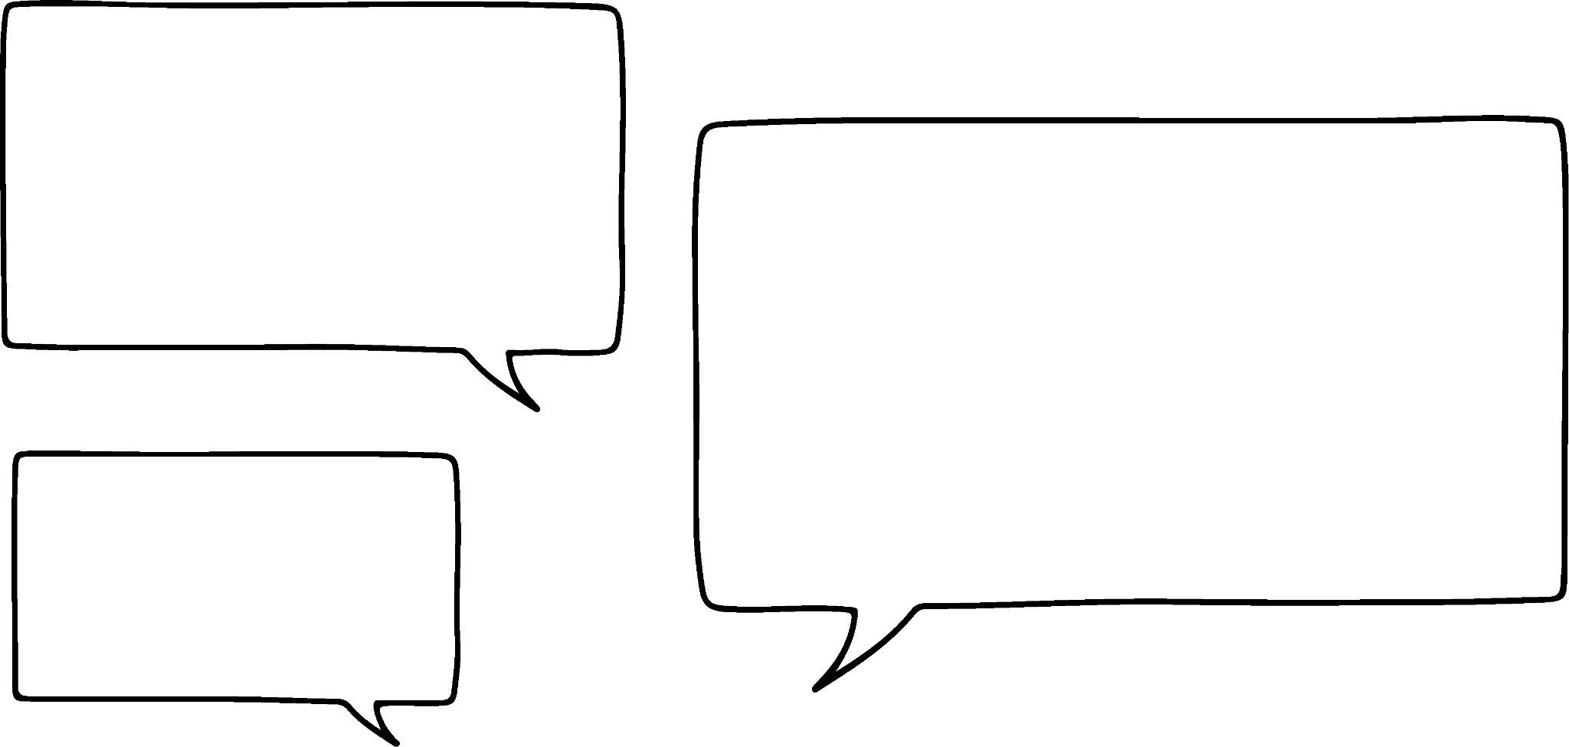
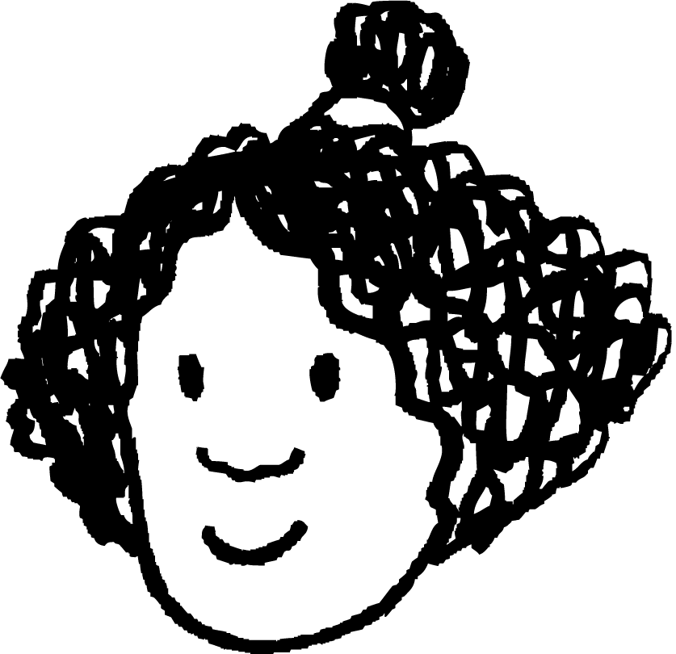
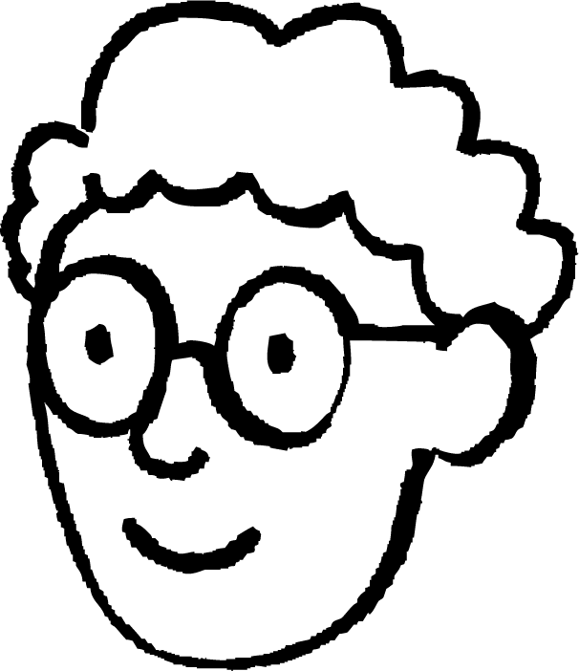
Identifying significant figures
Izzy and Alex are discussing which digit they think is the most significant in 123 456 789.
I think it is the 1 as that is the first digit.
I think it is the 9 as that is the highest number.
Izzy
Alex
One of them is correct.
Who do you think is correct?
The most significant figure is the figure that shows us the approximate size of the number.
Therefore, Alex is correct.

Slide 7
Identifying significant figures
So the first digit is the most significant.
Yes, I think so.
Izzy
Alex
Which is the most significant figure in 3456?
3 is the most significant figure in 3456.

Slide 8
Identifying significant figures
The first significant figure is the first non-zero digit in a number.
E.g. 18 the 1 is the most significant figure
293 the 2 is the most significant figure
5678 the 5 is the most significant figure
93 592 the 9 is the most significant figure

Slide 9
Identifying significant figures
I see what’s going on here, the first significant figure in a number is just the first digit.
No, it is the first non-zero digit.
Alex
Izzy
If I write the number 573 like this:
0573
is zero now the first significant figure?
Alex is correct.
The first significant figure in an integer is the first non-zero digit.

Slide 10

Identifying significant figures
In which of the following is 4 the first significant figure?
924 305
44 058
400 498
54 124

Slide 11
Identifying significant figures
Circle the first significant figure in each of the following:
a) 150 267
b) 3560
c) 60 253 461
d) 187
e) 98 200
f) 4 987 932

Slide 12
Identifying significant figures
Circle the first significant figure in each of the following:
a) 150 267
b) 3560
c) 60 253 461
d) 187
e) 98 200
f) 4 987 932

Slide 13
Rounding integers to one significant figure
Identifying significant figures
Using a number line for significant figures
Rounding to one significant figure

Slide 14
Using a number line for significant figures
That means we look at the column the first significant figure is in and then round to that.
I know that 4567 to one significant figure is 5000.
The first significant figure is in the thousands column.
Yes, and we are already super confident with that.
That is the same as 4567 to the nearest thousand.
Izzy
Alex

Slide 15











Using a number line for significant figures
What is 54 to one significant figure?
HMn | TMn | Mn | HTh | TTh | Th | H | T | O | T | H | Th | TTh
 |  |  |  |  |  |  | 5 | 4
th
th
th
th
.
.
The first significant figure is in the tens column.
Therefore, we round to the nearest 10.
54
50
55
60
54 rounded to one significant figure is 50

Slide 16
Using a number line for significant figures
What is 650 to one significant figure?
HMn | TMn | Mn | HTh | TTh | Th | H | T | O | T | H | Th | TTh
 |  |  |  |  |  | 6 | 5 | 0
th
th
th
th
.
.
The first significant figure is in the hundreds column.
Therefore, we round to the nearest 100.
600
650
700
650 rounded to one significant figure is 700
If the number is exactly halfway we round up.

Slide 17
Using a number line for significant figures
What is 2795 to one significant figure?
HMn | TMn | Mn | HTh | TTh | Th | H | T | O | T | H | Th | TTh
 |  |  |  |  | 2 | 7 | 9 | 5
th
th
th
th
.
.
The first significant figure is in the thousands column.
Therefore, we round to the nearest 1000.
2795
2000
2500
3000
2795 rounded to one significant figure is 3000

Slide 18
Using a number line for significant figures
What is 772 162 to one significant figure?
HMn | TMn | Mn | HTh | TTh | Th | H | T | O | T | H | Th | TTh
 |  |  | 7 | 7 | 2 | 1 | 6 | 2
th
th
th
th
.
.
The first significant figure is in the hundred thousands column.
Therefore, we round to the nearest 100 000.
772 162
700 000
750 000
800 000
772 162 = 800 000 (to 1 s.f.)

Slide 19
Using a number line for significant figures
What is 968 to one significant figure?
HMn | TMn | Mn | HTh | TTh | Th | H | T | O | T | H | Th | TTh
 |  |  |  |  |  | 9 | 6 | 8
th
th
th
th
.
.
The first significant figure is in the hundreds column.
Therefore, we round to the nearest 100.
968
900
950
1000
968 = 1000 (to 1 s.f.)

Slide 20
Using a number line for significant figures
Which of the following are correctly rounded to one significant figure?
5678 = 6000 (to 1 s.f.)
9678 = 100 000 (to 1 s.f.)
658 362 = 700 000 (to 1 s.f.)
5 103 564 = 500 000 (to 1 s.f.)

Slide 21
Using a number line for significant figures
Match the following to the correct rounded to one significant figure number:
3 487 925
thirty
28 021
three hundred
28
thirty thousand
348.7925
three million

Slide 22
Using a number line for significant figures
2) Complete the following:
Number | The 1st significant figure is in the _____ column. | Round to the nearest _____ . | Number line | To 1 s.f.
36
832
3519
43 867.09
992 782

Slide 23
Using a number line for significant figures
Match the following to the correct rounded to one significant figure number:
3 487 925
thirty
28 021
three hundred
28
thirty thousand
348.7925
three million

Slide 24
Using a number line for significant figures
2) Complete the following:
Number | The 1st significant figure is in the _____ column. | Round to the nearest _____ . | Number line | To 1 s.f.
36 | tens | 10 | 30 35 40 | 40
832 | hundreds | 100 | 800 850 900 | 800
3519 | thousands | 1000 | 3000 3500 4000 | 4000
43 867.09 | 10 thousands | 10 000 | 40 000 45 000 50 000 | 40 000
992 782 | 100 thousands | 100 000 | 900 000 950 000 1 000 000 | 1 000 000

Slide 25
Rounding integers to one significant figure
Identifying significant figures
Using a number line for significant figures
Rounding to one significant figure

Slide 26
Rounding to one significant figure
Round 65 784 to one significant figure.
HMn | TMn | Mn | HTh | TTh | Th | H | T | O | T | H | Th | TTh | HTh | Mh
 |  |  |  | 6 | 5 | 7 | 8 | 4
.
th
th
th
th
th
th
.
5 is exactly halfway
The first significant figure is in the ten thousands column.
Therefore, we round to the nearest ten thousand.
Therefore, we increase the digit in the 10 000 column by 1
65 784 = 70 000 (1 s.f.)
Ensure that the place holders are used in the thousands, hundreds, tens and ones columns to maintain the place value of the 7

Slide 27
Rounding to one significant figure
Round 1345.02 to one significant figure.
HMn | TMn | Mn | HTh | TTh | Th | H | T | O | T | H | Th | TTh | HTh | Mh
 |  |  |  |  | 1 | 3 | 4 | 5 | 0 | 2
.
th
th
th
th
th
th
.
3 is less than 5
The first significant figure is in the thousands column.
Therefore, we round to the nearest thousand.
Therefore, the digit in the thousands column stays the same.
1345.02 = 1000 (1 s.f.)
Ensure that the place holders are used in the hundreds, tens and ones columns to maintain the place value of the 1

Slide 28
Rounding to one significant figure
Alex rounds 87 392 to one significant figure.
What mistake has Alex made?
Alex has forgotten to replace the 7, 3, 9 and 2 with zeros, the place holders to maintain the place value of the 9.
87 392 = 90 000 (1 s.f.)
87 392 is 9 to one significant figure.
Alex

Slide 29
Rounding to one significant figure
Round 370.92 to one significant figure.
.
th
th
H | T | O | T | H
3 | 7 | 0 | 9 | 2
.
The digit in this column is greater than 5.
We will round up to the higher value.
370.92 = 400 (1 s.f.)

Slide 30
Rounding to one significant figure
Round 370.92 to one significant figure.
Round 63.91 to one significant figure.
.
th
th
.
th
th
H | T | O | T | H
3 | 7 | 0 | 9 | 2
H | T | O | T | H
 | 6 | 3 | 9 | 1
.
.
The digit in this column is greater than 5.
The digit in this column is less than 5.
We will round up to the higher value.
We will round down to the lower value.
370.92 = 400 (1 s.f.)
63.91 = 60 (1 s.f.)

Slide 31
Rounding to one significant figure
Write each of the numbers below to one significant figure, find the answer in the grid to complete this joke:
A sheepdog goes out to get the farmer’s sheep in. He comes back and says to the farmer, ‘that’s all 100 sheep in the barn’. The farmer says, ‘that’s odd we only had 97 this morning’. The sheepdog replies …
A | B | C | D | E | F | G | H | I | J | K | L | M
200 | 60 | 400 | 30 000 | 10 | 20 000 | 700 | 90 | 5000 | 20 | 100 | 9000 | 80 000
N | O | P | Q | R | S | T | U | V | W | X | Y | Z
70 | 2000 | 7000 | 40 | 8000 | 300 | 10 000 | 800 | 900 | 1000 | 50 000 | 40 | 600
4682 ≈
7) 65 ≈
8) 13 ≈
9) 840 ≈
10) 8287 ≈
11) 34 999 ≈
12) 1560 ≈
13) 25 873 ≈
14) 75 001 ≈
15) 94 ≈
16) 9810 ≈
17) 13 ≈
1800 ≈
1499 ≈
71 ≈
104 ≈
18) 7459 ≈
19) 762 ≈
6) 5498 ≈

Slide 32
Rounding to one significant figure
2) What values can the missing digit take?
4?90 = 4000 (1 s.f.)
? =
9?12 = 10 000 (1 s.f.)
? =
34 ?90 = 30 000 (1 s.f.)
? =
678? = 7000 (1 s.f.)
? =

Slide 33
Rounding to one significant figure
Write each of the numbers below to one significant figure, find the answer in the grid to complete this joke:
A sheepdog goes out to get the farmer’s sheep in. He comes back and says to the farmer, ‘that’s all 100 sheep in the barn’. The farmer says, ‘that’s odd we only had 97 this morning’. The sheepdog replies …
A | B | C | D | E | F | G | H | I | J | K | L | M
200 | 60 | 400 | 30 000 | 10 | 20 000 | 700 | 90 | 5000 | 20 | 100 | 9000 | 80 000
N | O | P | Q | R | S | T | U | V | W | X | Y | Z
70 | 2000 | 7000 | 40 | 8000 | 300 | 10 000 | 800 | 900 | 1000 | 50 000 | 40 | 600
4682 ≈ 5000 I
7) 65 ≈ 70 N
8) 13 ≈ 10 E
9) 840 ≈ 800 U
10) 8287 ≈ 8000 R
11) 34 999 ≈ 30 000 D
12) 1560 ≈ 2000 0
13) 25 873 ≈ 30 000 D
14) 75 001 ≈ 80 000 M
15) 94 ≈ 90 H 16) 9810 ≈ 10 000 T
17) 13 ≈ 10 E
1800 ≈ 2000 0
1499 ≈ 1000 W
71 ≈ 70 N
104 ≈ 100 K
18) 7459 ≈ 7000 P
19) 762 ≈ 800 U
6) 5498 ≈ 5000 I
‘I know, I rounded them up!’

Slide 34
Rounding to one significant figure
2) What values can the missing digit take?
4?90 = 4000 (1 s.f.)
0, 1, 2, 3 or 4
9?12 = 10 000 (1 s.f.)
5, 6, 7, 8, or 9
34 ?90 = 30 000 (1 s.f.)
any digit
678? = 7000 (1 s.f.)
any digit

Slide 35
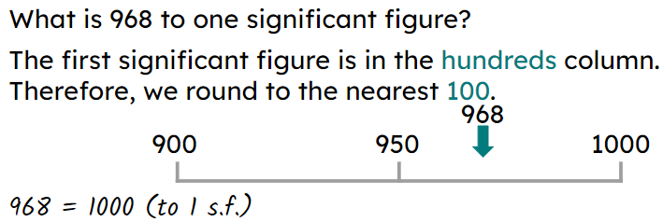
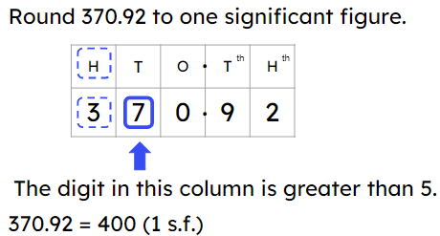
Rounding integers to one significant figure
Rounding to significant figures is the same as rounding to the nearest 10, 100, 1000, etc.
The first significant figure is the first non-zero digit.
Number lines can be used to round to one significant figure.
E.g.
Place value grids can be used to round to one significant figure.
E.g.

Slide 36

© Oak National Academy 2024.
Produced in partnership with Mathematics in Education and Industry.
Licensed on the Open Government Licence v3.0, except where otherwise stated. See Oak terms and conditions.

